Slide 1
Elementary Counting Techniques & Combinatorics
Martina Litschmannová
martina.litschmannova@vsb.cz
EA 538 (FEI)

Slide 2
Consider:
How many license plates are possible with 3 letters followed by 4 digits?
How many license plates are possible with 3 letters followed by 4 digits if no letter repeated?
How many different ways can we chose from 4 colors and paint 6 rooms?

Slide 3
Consider:
How many different orders may 9 people be arranged in a line?
How many ways can I return your tests so that no one gets their own?
How many distinct function exist between two given finite sets A and B?

Slide 4
Probability basics

Slide 5
Sets and subsets
Set Definitions
A set is a well-defined collection of objects.
Each object in a set is called an element of the set.
Two sets are equal if they have exactly the same elements in them.
A set that contains no elements is called a null set or an empty set.
If every element in Set A is also in Set B, then Set A is a subset of Set B.

Slide 6
Sets and subsets
Set Notation
A set is usually denoted by a capital letter, such as A, B…
An element of a set is usually denoted by a small letter, such as x, y, or z.
A set may be described by listing all of its elements enclosed in braces. For example, if Set A consists of the numbers 2, 4, 6 and 8, we may say: A = {2, 4, 6, 8}.
Sets may also be described by stating a rule. We could describe Set A from the previous example by stating: Set A consists of all the even single-digit positive integers.
The null set is denoted by {∅}.

Slide 7
Sets and subsets
Set Operations
The union of two sets is the set of elements that belong to one or both of the two sets.
Symbolically, the union of A and B is denoted by A ∪ B.

Slide 8
Sets and subsets
Set Operations
The intersection of two sets is the set of elements that are common to both sets.
Symbolically, the intersection of A and B is denoted by A ∩ B.

Slide 9
Sample problems
Describe the set of vowels.
$$A=\left\{a,e,i, o,u\right\}$$
Describe the set of positive integers.
Since it would be impossible to list all of the positive integers, we
need to use a rule to describe this set.
$$A=\left\{x:x∈ℤ ∧x>0\right\}$$
What is the set of men with four arms?
It is the null set (or empty set). $A=${$∅$}

Slide 10
Sample problems
Set A = {1, 2, 3} and Set B = {1, 2, 4, 5, 6}. Is Set A a subset of Set B?
Set A would be a subset of Set B if every element from Set A were also in Set B. However, this is not the case. The number 3 is in Set A, but not in Set B. Therefore, Set A is not a subset of Set B.

Slide 11
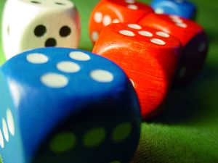
Stats experiments
Statistical experiments have three things in common:
The experiment can have more than one possible outcome.
Each possible outcome can be specified in advance.
The outcome of the experiment depends on chance.
Rolling dice

Slide 12
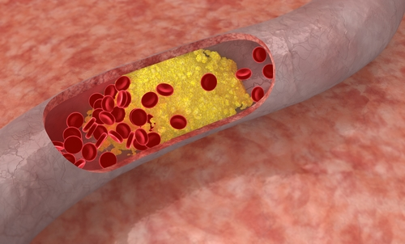
Stats experiments
Statistical experiments have three things in common:
The experiment can have more than one possible outcome.
Each possible outcome can be specified in advance.
The outcome of the experiment depends on chance.
Determining the amount of cholesterol in the blood

Slide 13
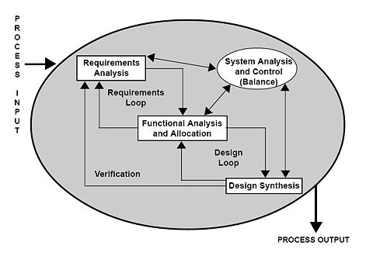
Stats experiments
Statistical experiments have three things in common:
The experiment can have more than one possible outcome.
Each possible outcome can be specified in advance.
The outcome of the experiment depends on chance.
Measurement of tasks number, which they require for a certain period

Slide 14
Stats experiments
Sample space $Ω$ is a set of elements that represents all possible outcomes of a statistical experiment.
A sample point is an element of a sample space.
An event is a subset of a sample space - one or more sample points.

Slide 15
Stats experiments
Types of events
Two events are mutually exclusive (disjoint) if they have no sample points in common.
Two events are independent when the occurrence of one does not affect the probability of the occurrence of the other.

Slide 16
Sample problems
Suppose I roll a die. Is that a statistical experiment?
Yes. Like a coin toss, rolling dice is a statistical experiment. There is more than one possible outcome. We can specify each possible outcome in advance. And there is an element of chance.
When you roll a single die, what is the sample space?
The sample space is all of the possible outcomes - $Ω= \left\{1, 2, 3, 4, 5, 6\right\}$.

Slide 17
Sample problems
Which of the following are sample points when you roll a die - 3, 6, and 9?
The number 9 is not a sample point, since it is outside the sample
space. The numbers 3 and 6 are sample points, because they are in
the sample space.
Which of the following sets represent an event when you roll a die?
$$A=\left\{1\right\}, B=\left\{2,4\right\}, C=\left\{2,4,6\right\}$$
Each of the sets shown above is a subset of the sample space, so
each represents an event.

Slide 18
Sample problems
Consider the events listed below. Which are mutually exclusive? A. {1} B. {2, 4} C. {2, 4, 6}
Two events are mutually exclusive, if they have no sample points in common.
$A∩B=$ {$∅$}
$$A∩C=\left\{∅\right\}$$
$$B∩C≠\left\{∅\right\}$$

Slide 19
Sample problems
Suppose you roll a die two times. Is each roll of the die an independent event?
Yes. Two events are independent when the occurrence of one has no effect on the probability of the occurrence of the other. Neither roll of the die affects the outcome of the other roll; so each roll of the die is independent.

Slide 20
Combinatorics

Slide 21
Combinatorics
is the branch of discrete mathematics concerned with determining the size of finite sets without actually enumerating each element.

Slide 22
Product rule
occurs when two or more independent events are grouped together. The first rule of counting helps us determine how many ways an event multiple can occur.
Suppose we have k independent events. Event 1 can be performed in n₁ ways; Event 2, in n₂ ways; and so on up to Event k, which can be performed in n_{k} ways. The number of ways that these events can be performed together is equal to n₁n₂ . . . n_{k} ways.

Slide 23
How many sample points are in the sample space when a coin is flipped 4 times?
Coin flipp – 2 outcomes (head or tails)
Flipp 1
Flipp 2
Flipp 3
Flipp 4
2
$$∙$$
2
$$∙$$
2
$$∙$$
2
$$=16$$

Slide 24
A business man has 4 dress shirts and 7 ties. How many different shirt/tie outfits can he create?
Dress shirts
Ties
4
$$∙$$
7
$$=28$$

Slide 25
How many different ways can we chose from 4 colors and paint 3 rooms?
Room 1
Room 2
Room 3
4
$$∙$$
4
$$∙$$
4
$$=64$$

Slide 26
How many different ways can we chose from 4 colors and paint 3 rooms, if no room is to be the same color?
Room 1
Room 2
Room 3
4
$$∙$$
3
$$∙$$
2
$$=24$$

Slide 27
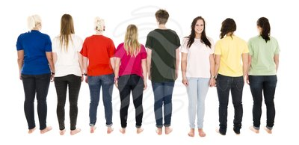
How many different orders may 8 people be arranged in?
Pos 1
Pos 2
Pos 3
Pos 4
Pos 5
Pos 6
Pos 7
Pos 8
8
$$∙$$
7
$$∙$$
6
$$∙$$
5
$$∙$$
4
$$∙$$
3
$$∙$$
2
$$∙$$
1
$$=8!=362 880$$

Slide 28
How many different 3 people can be selected from a group of 8 people to a president, vice-president, treasure of the group?
president
Vice-president
Treasure
8
$$∙$$
7
$$∙$$
6
$$=336$$

Slide 29
How many license plates are possible with 3 letters followed by 4 digits?
A
B
C
.
.
.
Z
0
1
2
.
.
.
9
26
10
$=26.26.26.10.10.10.10=$17 576 000

Slide 30
The Sum Rule (task formulation):
Suppose that a task can be completed by performing exactly one task from a collection of disjoint subtasks:
subtask₁, subtask₂, ... , subtask_{k}.
Now suppose each subtask has a choice of ways to perform it, e.g.
subtask₁ can be performed t₁ ways,
subtask₂ can be performed t₂ ways,
...
subtask_{k} can be performed t_{k} ways.
Then number the number of ways to perform the task is:
$$t_{1}+t_{2}+…+t_{k}$$

Slide 31
You have five novels, four magazines, and three devotional books. How many options do you have for taking one for your wait in the bank line?
3 subtasks - pick a novel, pick a magazine, or pick a devotional book.
Novels
Magazines
Books
5
+
4
+
3
$$=12$$

Slide 32
Consider the following road map. a) How many ways are there to travel from A to B, and back to A, without going through C?
A
B
C

Slide 33
Consider the following road map. a) How many ways are there to travel from A to B, and back to A, without going through C?
A
B
C
from A to B: 4 ways
from B to A: 4 ways
There are $16 \left(=4∙4\right)$ ways to travel from A to B, and back to A, without going through C.

Slide 34
Consider the following road map. b) How many ways are there to go from A to C, stopping once at B?
A
B
C
from A to B
from B to C
4
$$∙$$
2
$$=8$$
OR
from A to B
from B to A
from A to C
$$=24$$
4
$$∙$$
4
$$∙$$
1
$$=16$$

Slide 35
Consider the following road map. c) How many ways are there to go from A to C, making at most one intermediate stop?
A
B
C
Without intermediate stop: 1 way
With 1 intermediate stop: 8 ways
------------------------------------------
At most one intermediate stop: $1+8=9 ways$

Slide 36
The Pigeonhole Principle
If k + 1 or more objects are placed in k boxes, then there is
at least one box containing two or more objects.

Slide 37
The Pigeonhole Principle
If k + 1 or more objects are placed in k boxes, then there is
at least one box containing two or more objects.

Slide 38
The Pigeonhole Principle
If k + 1 or more objects are placed in k boxes, then there is
at least one box containing two or more objects.

Slide 39
Sample problems
Among 367 people, there must be at least 2 with the same birthday, since there is only 366 possible birthdays.
In a collection of 11 numbers, at least 2 must have the same least significant digit.

Slide 40
The Generalized Pigeonhole Principle
If N objects are placed into k boxes, then there is at least one box containing at least ⎡N/k⎤ objects.
⎡a⎤ is smallest integer larger than or equal to a
(ceiling function)

Slide 41
Sample problems
Among 100 people there are at least ⎡100/12⎤ = 9 people with the same birthday month.
At FEI, VŠB-TUO there are at least ⎡3619/366⎤ = 10 people with the same birthday.

Slide 42
In a class of 44 students, how many will receive the same grade on a scale {A, B, C, D, F}?
$$\left\lceil 44/5\right\rceil =9$$

Slide 43
How many people must we survey, to be sure at least 50 have the same political party affiliation, if we use the three affiliations {Democrat, Republican, neither}?
$$\left\lceil N/3\right\rceil =50$$
$$N=3∙49+1=148$$

Slide 44
Permutations and Combinations

Slide 45
Consider:
How many ways can we choose
r things from a collection of n things?
pick
Pick 4 from 9 colored balls

Slide 46
Consider:
How many ways can we choose
r things from a collection of n things?
This statement is ambiguous in several ways:
Are the n things distinct or indistinguishable?
Do the selected items form a set (unordered collection) or a sequence (ordered)?
May the same item be selected from the r items more then once? (Are repetitions permitted?)

Slide 47
Consider:
How many ways can we choose
r things from a collection of n things?
pick
Example using balls:
Are the balls identical or different colors? Are some different colors, others the same?
Are balls tossed in a bucket (unordered) or lined up in a line in the order chosen?
Each ball returned to the collection before the next is selected?

Slide 48
Permutations
An ordered selection of objects.
If there is a collection of n objects to chose from, and we are selecting all n objects, then we call each possible selection a permutation from the collection.
In the general case the items are all distinct, and repetitions are not permitted.

Slide 49
Permutations
Possible permutations of three colored balls:

Slide 50
Permutations
1. object
2. object
3. object
…
n. object
$$∙$$
1
n
$$∙$$
n-1
$$∙$$
n-2
$$⋯$$
$$∙$$
$$P\left(n\right)=n!$$
Thus, by the product rule, the number of ways to arrange n objects is: $n∙\left(n−1\right)∙⋯∙1=n!$
The number of permutations of a set of n objects is the product of the first n positive integers, that is n!

Slide 51
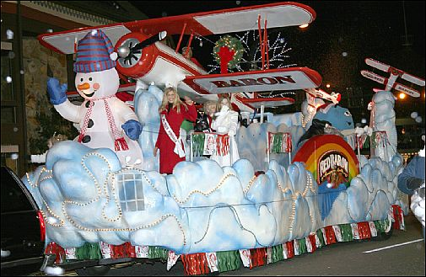
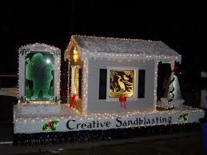
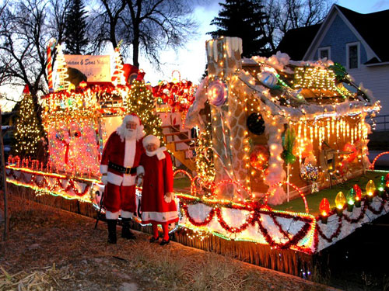
How many ways are there to arrange 9 floats in the Christmas parade?
$$P\left(9\right)=9!=362 880$$

Slide 52
r-Permutations
Consider ordering a subset of a collection of n different objects.
If there is a collection of n objects to chose from, and we are selecting r of the objects, where $O<r≤n$, then we call each possible selection a r-permutation from the collection.

Slide 53
r-Permutations
Consider a 4-permutation of 9 balls.
pick
$$∙∙∙$$
1. ball
2. ball
3. ball
4. ball
9
$$∙$$
8
$$∙$$
7
$$∙$$
6
$$=3024$$

Slide 54
r-Permutations
1. object
2. object
3. object
…
r. object
n
$$∙$$
n-1
$$∙$$
n-2
$$∙$$
$$⋯$$
$$∙$$
n-r+1
$$P\left(n;r\right)=\frac{n!}{\left(n−r\right)!}$$
Thus, by the product rule, the number of ways to arrange r of n objects is: $n∙\left(n−1\right)∙⋯∙\left(n−r+1\right)=\frac{n!}{\left(n−r\right)!}$
The number of r-permutations is $\frac{n!}{\left(n−r\right)!}.$

Slide 55
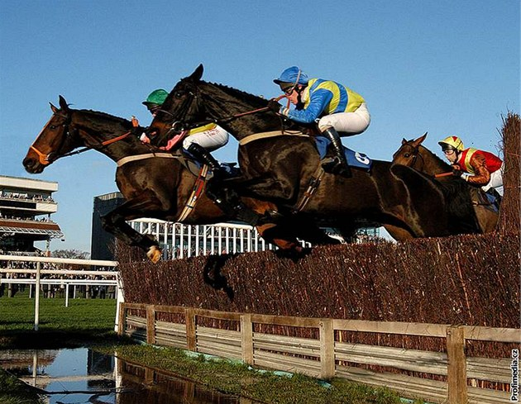
Consider a horse race with 8 horses. If a spectator were select three different horses at random to bet on for first, second and third places, how likely is he to be completely correct?
$$P\left(8;3\right)=\frac{8!}{5!}=8∙7∙6=336$$
Thus he has 1 in 336 chance.

Slide 56
Combinations
Combination - an unordered selection of objects.
Consider a set S with n objects. Every r sized subset of those objects (0<r≤n) is a combination of size r, or a r-combination taken from S.

Slide 57
Sample problems
Consider the set $A=\left\{a,b,c\right\}.$
What are the 2-combinations of A?
$\left\{a,b\right\} \left\{a,c\right\} \left\{b,c\right\}$
What are the 3-combinations of A?
$\left\{a,b,c\right\}$
What are the 1-combinations of A?
$\left\{a\right\} \left\{b\right\} \left\{c\right\}$

Slide 58
Sample problems
Consider the set $B=\left\{a,b,c,d\right\}.$
What are the 2-combinations of B?
$\left\{a,b\right\} \left\{a,c\right\} \left\{a,d\right\}$ $\left\{b,c\right\} \left\{b,d\right\} \left\{c,d\right\}$
What are the 3-combinations of B?
$\left\{a,b,c\right\}$ $\left\{a,b,d\right\}$ $\left\{a,c,d\right\}$ $\left\{b,c,d\right\}$

Slide 59
r-permutations vs. r- combinations
Notice the comparison
of 3-combinations of B with 3-permutations:
3-permutations 3-combinations
abc acb bac bca cba cab {a, b, c}
abd adb bad bda dba dab {a, b, d}
adc acd dac dca cda cad {a, c, d}
dbc dcb bdc bcd cbd cdb {b, c, d}

Slide 60
Combinations
This shows that each r-combination has r-permutations possible.
$$C\left(n;r\right)=\frac{P\left(n;r\right)}{r!}=\frac{n!}{r!\left(n−r\right)!}=\left(\begin{matrix}n \\ r\end{matrix}\right)$$
The number of r-combinations is$\left(\begin{matrix}n \\ r\end{matrix}\right).$
Read „n choose r objects“.

Slide 61
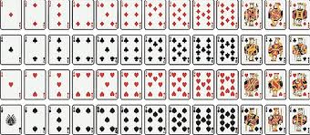
How many different 5-card hands can be made from a deck of 52 cards?
$$C\left(52;5\right)=\frac{52!}{5!\left(52−5\right)!}=\frac{52!}{5!47!}=\frac{52∙51∙50∙49∙48}{5∙4∙3∙2∙1}=$$
$=2 598 960$

Slide 62
A certain club has 5 male and 7 female members. a) How many ways can any 7 member committee be selected from the membership?
a) $C\left(12;7\right)=\frac{12!}{7!\left(12−7\right)!}=\frac{12!}{7!∙5!}=\frac{12∙11∙10∙9∙8}{5∙4∙3∙2∙1}$=792

Slide 63
A certain club has 5 male and 7 female members. b) How many ways are there to form a 7 member committee consisting of 3 men and 4 women?
Two tasks - pick a man, then pick a woman.
Thus: $C\left(5;3\right)∙C\left(7;4\right)=\left(\begin{matrix}5 \\ 3\end{matrix}\right)\left(\begin{matrix}7 \\ 4\end{matrix}\right)=10∙35=350$

Slide 64
A certain club has 5 male and 7 female members. c) How many ways are there to form a committee of 6 people if 2 woman refuse to serve together?
$C\left(12;6\right)−C\left(10;4\right)=924−210$=714

Slide 65
A certain club has 5 male and 7 female members. d) How many ways are there to form a committee of 4 men and 3 woman if 2 men refuse to serve together?
$\left(C\left(5;4\right)−C\left(3;2\right)\right)∙$ $C\left(7;3\right)=\left(5−3\right)∙35=70$

Slide 66
Study materials :
http://homel.vsb.cz/~bri10/Teaching/Bris%20Prob%20&%20Stat.pdf
(p. 34 - p.41)
http://onlinestatbook.com/2/probability/permutations.html
http://en.wikipedia.org/wiki/Pigeonhole_principle

