Slide 1
Continous Probability Distributions
Martina Litschmannová
martina.litschmannova@vsb.cz
EA 538

Slide 2
Probability Distribution of Continous Random Variable

Slide 3
Probability Density Function
Unlike a discrete random variable, a continuous random variable is one that can assume an uncountable number of values.
We cannot list the possible values because there is an infinite number of them.
Because there is an infinite number of values, the probability of each individual value is virtually 0.
X … continous random variable $⇒$ $∀x∈ℝ: P\left(X=x\right)=0$

Slide 4
Point Probabilities are Zero
Because there is an infinite number of values, the probability of each individual value is virtually 0.
Thus, we can determine the probability of a range of values only.
E.g. with a discrete random variable like tossing a die, it is meaningful to talk about P(X=5), say.
In a continuous setting (e.g. with time as a random variable), the probability the random variable of interest, say task length, takes exactly 5 minutes is infinitesimally small, hence P(X=5) = 0.
It is meaningful to talk about P(X ≤ 5).

Slide 5
Probability Density Function f(x)
A function $f(x)$ is called a probability density function (over the range $a ≤ x ≤ b$if it meets the following requirements:
$f(x) ≥ 0$for all $x$ between $a$ and $b$, and
The total area under the curve between $a$ and $b$ is 1,0.
$$f(x)$$
area=1
$$a$$
$$b$$
$$x$$

Slide 6
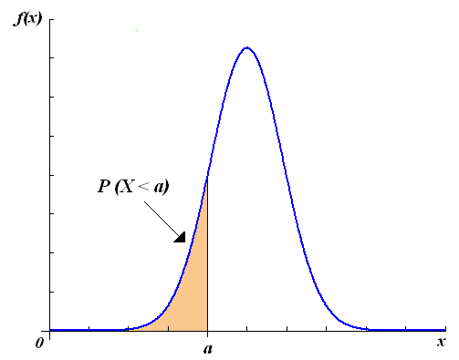
Relationship between probability density function f(x) and distribution function F(x)
$$F\left(x\right)=\int_{−∞}^{x}{f\left(t\right) dt}$$

Slide 7
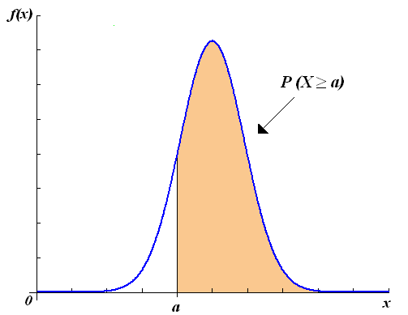
Relationship between probability density function f(x) and distribution function F(x)
$$F\left(x\right)=\int_{−∞}^{x}{f\left(t\right) dt}$$

Slide 8
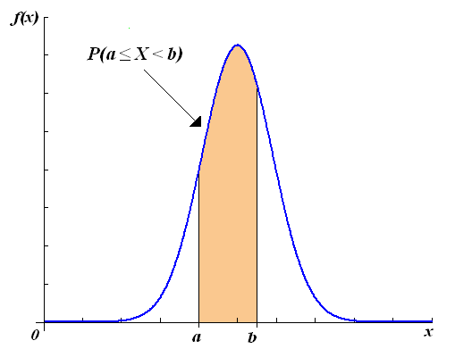
Relationship between probability density function f(x) and distribution function F(x)
$$F\left(x\right)=\int_{−∞}^{x}{f\left(t\right) dt}$$

Slide 9
The Uniform Distribution
Consider the uniform probability distribution (sometimes called the rectangular probability distribution).
It is described by the function:
$$f\left(x\right)=\frac{1}{b−a}, where a≤x≤b$$
f(x)
a
b
x
area = width $∙$ height = $\left(b−a\right)∙\frac{1}{b−a}=1$

Slide 10
The amount of gasoline sold daily at a service station is uniformly distributed with a minimum of 2,000 gallons and a maximum of 5,000 gallons. What is the probability that the service station will sell at least 4,000 gallons?
X … amount of gasoline sold daily at service station
$$P\left(X≥4000\right)=P\left(X>4000\right)= ?$$

Slide 11
The amount of gasoline sold daily at a service station is uniformly distributed with a minimum of 2,000 gallons and a maximum of 5,000 gallons. What is the probability that the service station will sell at least 4,000 gallons?
X … amount of gasoline sold daily at service station
$$P\left(X>4000\right)=\left(5000−4000\right)∙\frac{1}{3000}=0,\overline{3}$$
f(x)
$$\frac{1}{3000}$$
2000
5000
x

Slide 12
The Normal Distribution
The normal distribution is the most important of all probability distributions. The probability density function of a normal random variable is given by:
$$f\left(x\right)=\frac{1}{σ\sqrt{2π}}e^{−\frac{1}{2}{\left(\frac{x−μ}{σ}\right)}^{2}}, where −∞<x<∞$$
It looks like this:
Bell shaped,
Symmetrical around the mean

Slide 13
The Normal Distribution
Important things to note:
The normal distribution is fully defined by two parameters: its standard deviation and mean.
$$f\left(x\right)=\frac{1}{σ\sqrt{2π}}e^{−\frac{1}{2}{\left(\frac{x−μ}{σ}\right)}^{2}}, where −∞<x<∞$$

Slide 14
The Normal Distribution
Important things to note:
The normal distribution is bell shaped and symmetrical about the mean.
For a normal distribution, each inflection point is always one sigma away from the mean.
Unlike the range of the uniform distribution ($a ≤ x ≤ b$). Normal distributions range from minus infinity to plus infinity.

Slide 15
The Normal Distribution
$$σ$$
$$σ$$
$$μ$$
$$−∞$$
$$∞$$

Slide 16
The Normal Distribution
Important things to note:
Distribution function: $F\left(x\right)=\frac{1}{σ\sqrt{2π}}\int_{−∞}^{x}{e^{−\frac{1}{2}{\left(\frac{t−μ}{σ}\right)}^{2}}}dt$
(integral can not be solved analytically)

Slide 17
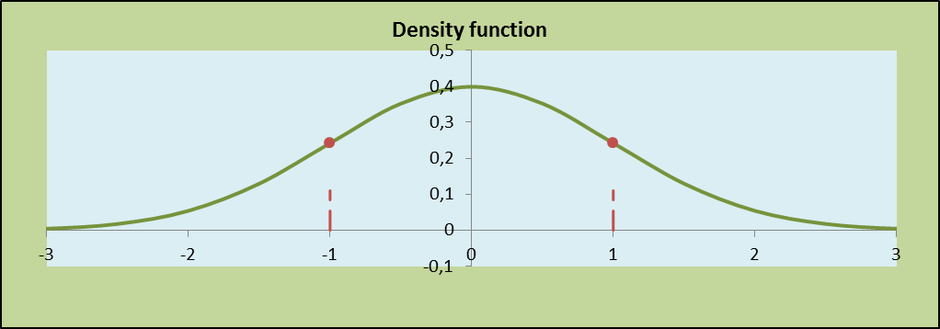
Standard Normal Distribution
A normal distribution whose mean is zero and standard deviation is one is called the standard normal distribution.
$$φ\left(x\right)=\frac{1}{1\sqrt{2π}}e^{−\frac{1}{2}{\left(\frac{x−0}{1}\right)}^{2}}, where −∞<x<∞$$

Slide 18
Standard Normal Distribution
A normal distribution whose mean is zero and standard deviation is one is called the standard normal distribution.
$$φ\left(x\right)=\frac{1}{1\sqrt{2π}}e^{−\frac{1}{2}{\left(\frac{x−0}{1}\right)}^{2}}, where −∞<x<∞$$
Distribution function $Φ\left(x\right)$ is tabulated (rectangular method).

Slide 19
Calculating Normal Probabilities
Let $X→N\left(μ; σ^{2}\right)$. We define the random variable Z, often called the z-score, as
$Z=\frac{X−μ}{σ}.$
Random variable Z has a standard normal distribution, $Z→N\left(0;1\right)$.
Between the distribution function of a normal random variable X and the standard normal random variable Z true conversion relationship
$$F\left(x\right)=Φ\left(\frac{x−μ}{σ}\right).$$
Proof:
$$F\left(x\right)=P\left(X<x\right)=P\left(Zσ+μ<x\right)=P\left(Z<\frac{x−μ}{σ}\right)=Φ\left(\frac{x−μ}{σ}\right)$$

Slide 20
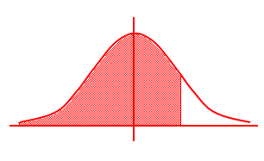
Using the Normal Table
What is $P\left(Z<1,52\right)$ ?
$$P\left(Z<1,52\right)=Φ\left(1,52\right)=0,9357$$
z
0
1,52
tabulated

Slide 21
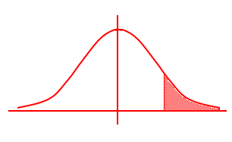
Using the Normal Table
What is $P\left(Z>1,6\right)$ ?
$P\left(Z>1,6\right)=1−$ $P\left(Z<1,6\right)=1−Φ\left(1,6\right)=1−0,9452=$
$=0,0548$
z
0
1,6
tabulated

Slide 22
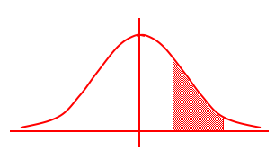
Using the Normal Table
What is $P\left(0,9<Z<1,9\right)$ ?
$$P\left(0,9<Z<1,9\right)=Φ\left(1,9\right)−Φ\left(0,9\right)=0,9713−0,8159=$$
$=0,1554$
z
0
0,9
1,9

Slide 23
Using the Normal Table
What is $P\left(Z<−1,6\right)$ ?
$$P\left(Z<−1,6\right)=Φ\left(−1,6\right)=1−Φ\left(1,6\right)=1−0,9452=$$
$=0,0548$
z
-1,6
0
1,6
tabulated

Slide 24
Using the Normal Table
$$X→N\left(μ=1;σ=2\right)$$
What is $P\left(X<1,52\right)$ ?
$$F\left(x\right)=Φ\left(\frac{x−μ}{σ}\right)$$
$$P\left(X<1,52\right)=F\left(1,52\right)=Φ\left(\frac{1,52−1}{2}\right)=Φ\left(0,26\right)=0,6026$$

Slide 25
The time required to build a computer is normally distributed with a mean of 50 minutes and a standard deviation of 10 minutes. What is the probability that a computer is assembled in a time between 45 and 60 minutes?
X … the time required to build a computer
$X→N\left(μ=50;σ=10\right)$
$$P\left(45<X<60\right)=F\left(60\right)−F\left(45\right)=$$
$=Φ\left(\frac{60−50}{10}\right)−$ $Φ\left(\frac{45−50}{10}\right)=$
$$=Φ\left(1\right)−Φ\left(−0,5\right)=$$
$$=Φ\left(1\right)−\left(1−Φ\left(0,5\right)\right)=$$
$$=Φ\left(1\right)+Φ\left(0,5\right)−1=$$
$$=0,8413+0,6915−1=$$
$=0,$5328
http://www.math.unb.ca/~knight/utility/NormTble.htm

Slide 26
The return on investment is normally distributed with a mean of 10% and a standard deviation of 5%. What is the probability of losing money?
X … return on investment
$X→N\left(μ=10;σ=5\right)$
$P\left(X<0\right)=F\left(0\right)=Φ\left(\frac{0−10}{5}\right)=$ $Φ\left(−2\right)=1−Φ\left(2\right)=$
$=1−0,9772=0,$0228

Slide 27
Finding Value of $z_{p}$
Often we’re asked to find some value of Z for a given probability, i.e. given an area (p) under the curve, what is the corresponding value of z (z_{p}) on the horizontal axis that gives us this area? That is:
$P\left(Z<z_{0,75}\right)=0,75⇒Φ\left(z_{0,75}\right)=0,75⇒$ $z_{0,75}=Φ^{−1}\left(0,75\right)=0,675$
Area p = 0,75
0
1,52
z
$$z_{p}$$
0

Slide 28
Finding Value of $z_{p}$
What is$z_{0,25}$?
$$P\left(Z<z_{0,25}\right)=0,25⇒Φ\left(z_{0,25}\right)=0,25⇒ z_{0,25}=Φ^{−1}\left(0,25\right)$$
$$z_{0,25}=−z_{0,75}=−0,675$$
Area p = 0,25
z
$$z_{0,25}$$
0
$$z_{0,75}$$
Is not tabulated

Slide 29
X has normal distribution with mean $μ$ and standard distribution $σ$. What is $P\left(μ−σ<X<μ+σ\right)$?
$X→N\left(μ;σ\right)$
$$P\left(μ−σ<X<μ+σ\right)=F\left(μ+σ\right)−F\left(μ−σ\right)=$$
$=Φ\left(\frac{μ+σ−μ}{σ}\right)−$ $Φ\left(\frac{μ−σ−μ}{σ}\right)=$
$$=Φ\left(1\right)−Φ\left(−1\right)=$$
$$=Φ\left(1\right)−\left(1−Φ\left(1\right)\right)=$$
$$=2Φ\left(1\right)−1=$$
$$=2∙0,8413−1=$$
$=0,$6826
http://www.math.unb.ca/~knight/utility/NormTble.htm

Slide 30
X has normal distribution with mean $μ$ and standard distribution $σ$. What is $P\left(μ−2σ<X<μ+2σ\right)$?
$X→N\left(μ;σ\right)$
$$P\left(μ−2σ<X<μ+2σ\right)=F\left(μ+2σ\right)−F\left(μ−2σ\right)=$$
$=Φ\left(\frac{μ+2σ−μ}{σ}\right)−$ $Φ\left(\frac{μ−2σ−μ}{σ}\right)=Φ\left(2\right)−Φ\left(−2\right)=Φ\left(2\right)−\left(1−Φ\left(2\right)\right)=$
$$=2Φ\left(2\right)−1=2∙0,9772−1=0,9544$$

Slide 31
X has normal distribution with mean $μ$ and standard distribution $σ$. What is $P\left(μ−3σ<X<μ+3σ\right)$?
$X→N\left(μ;σ\right)$
$$P\left(μ−3σ<X<μ+3σ\right)=F\left(μ+3σ\right)−F\left(μ−3σ\right)=$$
$=Φ\left(\frac{μ+3σ−μ}{σ}\right)−$ $Φ\left(\frac{μ−3σ−μ}{σ}\right)=Φ\left(3\right)−Φ\left(−3\right)=Φ\left(3\right)−\left(1−Φ\left(3\right)\right)=$
$$=2Φ\left(3\right)−1=2∙0,9987−1=0,9974$$

Slide 32
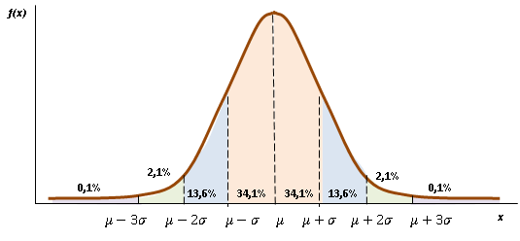
Rule of 3$σ$
k | $$P\left(μ−kσ<X<μ+kσ\right)$$
1 | 0,682
2 | 0,954
3 | 0,998

Slide 33
The time ($Y$) it takes your professor to drive home each night is normally distributed with mean 15 minutes and standard deviation 2 minutes. Find the following probabilities. Draw a picture of the normal distribution and show (shade) the area that represents the probability you are calculating. $P(Y > 25) =$ $P\left( 11 < Y < 19\right)=$ $P (Y ≤18) =$

Slide 34
The manufacturing process used to make “heart pills” is known to have a standard deviation of 0,1 mg of active ingredient. Doctors tell us that a patient who takes a pill with over 6 mg of active ingredient may experience kidney problems. Since you want to protect against this (and most likely lawyers), you are asked to determine the “target” for the mean amount of active ingredient in each pill such that the probability of a pill containing over 6 mg. is 0,0035 ( 0,35% ). You may assume that the amount of active ingredient in a pill is normally distributed. a) Solve for the target value for the mean. b) Draw a picture of the normal distribution you came up with and show the 3 sigma limits.

Slide 35
The Exponential Distribution
Another important continuous distribution is the exponential distribution which has this probability distribution function:
$F\left(x\right)=1−e^{−λx}, where x≥0; λ>0$
$$X→Exp\left(λ\right)$$
Note that $x≥0$. Time (for example) is a non-negative quantity; the exponential distribution is often used for time related phenomena such as the length of time between events (for example: phone calls or between parts arriving at an assembly station). Note also that the mean and standard deviation are equal to each other and to the inverse of the parameter of the distribution ($λ$).

Slide 36
The Exponential Distribution
Important things to note:
The Exponential Distribution is said to be without memory, i.e.
$$P\left(X>t_{1}+t_{2}|X>t_{1}\right)=P\left(X>t_{2}\right)$$
$$0$$
$$t_{1}$$
$$t_{1}+t_{2}$$
$$t_{2}$$

Slide 37
The Exponential Distribution
Important things to note:
$$X→Exp\left(λ\right)$$
$E\left(X\right)=\frac{1}{λ}$ and $D\left(X\right)=\frac{1}{λ^{2}}$

Slide 38
The Exponential Distribution
Hazard function - Failure rate is the frequency with which an engineered system or component fails, expressed, for example, in failures per hour. It is often denoted by the greek letter λ (lambda) and is important in reliability engineering.
For non-negative random variable X with continuous distribution described by distribution function 𝐹 (𝑡) is failure rate given as
$$λ\left(t\right)=\frac{f\left(t\right)}{1−F\left(t\right)}, F\left(t\right)≠1.$$

Slide 39
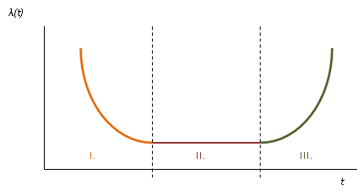
Hazard function
Infant mortality
Random failures
Wear-out failures

Slide 40
The Exponential Distribution
$$X→Exp\left(λ\right)$$
$F\left(x\right)=1−e^{−λx}, where x≥0; λ>0$
$$f\left(x\right)=λe^{−λx}, where x≥0; λ>0$$
$$λ\left(x\right)=\frac{f\left(x\right)}{1−F\left(x\right)}=\frac{λe^{−λx}}{1−\left(1−e^{−λx}\right)}=λ$$

Slide 41
Hazard function
Infant mortality
Random failures
Wear-out failures
Exponential distribution

Slide 42
The Exponential Distribution
What gives value $λ\left(t\right)$?
X represents the random variable - time to failure of a device. The probability that if $X>t$, then an event occurs in the following short section $∆t$ is approximately
$P\left(t≤X<t+∆t|X>t\right)≅\frac{P\left(t<X<t+∆t\right)}{P\left(X>t\right)}=\frac{f\left(t\right)∙∆t}{1−F\left(t\right)}=λ\left(t\right)∙∆t$.
$$t$$
$$t+∆t$$
$$∆t$$

Slide 43
Suppose the response time $X$ at a certain on-line computer terminal (the elapsed time between the end of a user’s inquiry and the beginning of the system’s response to that inquiry) has an exponential distribution with expected response time equal to 5 sec. a) What is the probability that the response time is at most 10 seconds? b) What is the probability that the response time is between 5 and 10 seconds? c) What is the value of x for which the probability of exceeding that value is 1%?

Slide 44
The Weibull Distribution
A random variable X is said to have the Weibull Probability Distribution with parameters β and θ, where β > 0 and θ > 0, if the probability distribution function of X is:
$$F\left(x\right)=1−e^{−{\left(λx\right)}^{β}}, where x≥0; Θ=\frac{1}{λ}>0, β>0$$
$$X→W\left(θ;β\right)$$
Where, β is the Shape Parameter, θ is the Scale Parameter.
Note: If β = 1, the Weibull reduces to the Exponential Distribution.
http://keisan.casio.com/exec/system/1180573175

Slide 45
The Weibull Distribution
A random variable X is said to have the Weibull Probability Distribution with parameters β and θ, where β > 0 and θ > 0, if the probability distribution function of X is:
$$F\left(x\right)=1−e^{−{\left(λx\right)}^{β}}, where x≥0; Θ=\frac{1}{λ}>0, β>0$$
$$X→W\left(θ;β\right)$$
$$f\left(x\right)=βλ^{β}t^{β−1}e^{−{\left(λx\right)}^{β}}, where x≥0; Θ=\frac{1}{λ}>0, β>0$$
$λ\left(x\right)=βλ^{β}x^{β−1}, where x≥0; Θ=\frac{1}{λ}>0, β>0$

Slide 46
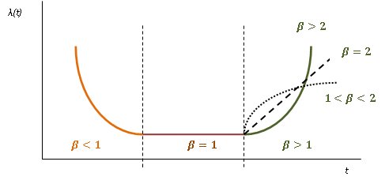
The Weibull Distribution
$$λ\left(x\right)=βλ^{β}x^{β−1}, where x≥0; Θ=\frac{1}{λ}>0, β>0$$

Slide 47
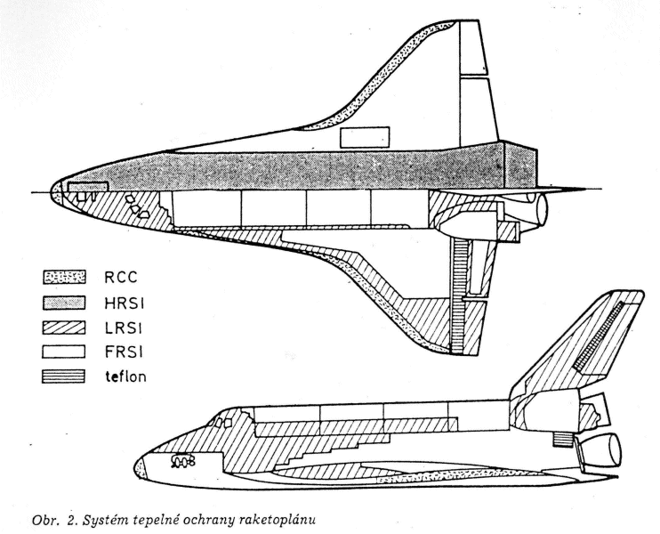
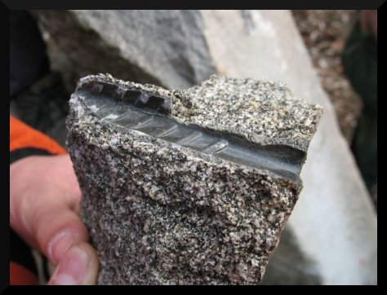
Let $X$ = the ultimate tensile strength (ksi) at -200 degrees $F$ of a type of steel that exhibits ‘cold brittleness’ at low temperatures. Suppose $X$ has a Weibull distribution with parameters β = 20, and θ = 100. Find: a) $P( X  105)$ b) $P(98  X  102)$ c) the value of x such that $P( X  x) = 0,10$

Slide 48
The random variable $X$ can modeled by a Weibull distribution with β = ½ and θ = 1000. The spec time limit is set at $x$ = 4000. What is the proportion of items not meeting spec?

Slide 49
Study materials :
http://homel.vsb.cz/~bri10/Teaching/Bris%20Prob%20&%20Stat.pdf
(p. 80 - p.93)
http://stattrek.com/tutorials/statistics-tutorial.aspx
(Distributions - Continous)

